Slide 1
Chronic Kidney Disease in children
Dr Bashir Admani
Paediatric Nephrology

Slide 2
Definition
Chronic Renal Failure or Chronic Renal Insufficiency clinical terms to describe renal dysfunction of varying degrees
Mild- severe
Chronic Kidney Disease term that is being favored as it defines renal dysfunction as a continuum rather than a discrete change in renal function

Slide 3
Definitions (N/DOQI)
CKD stage
GFR (ml/min/1.73m²)
1
normal renal function
2
60 – 89
3
30 – 59
4
15 – 29
5
<15 & dialysis

Slide 4
Causes
Cause of end-stage renal failure in the UK paediatric population*
Diagnostic group % of total
Primary renal dysplasia 27.7
Obstructive uropathy 20.2
Glomerulonephritis/vasculitis/glomerulopathy 17.3
Primary focal segmental glomerulosclerosis 6.4
D+ haemolytic uraemic syndrome 2.9
Henoch Schönlein nephritis 1.6
Reflux nephropathy 7.2
Primary tubular and interstitial disorders 7.3
Congential nephrotic syndrome 6.9
Chronic renal failure of uncertain aetiology 2
Others 11.4
*Modified from Report of the Paediatric Renal Registry, 1
Egypt showed increased obstructive uropathy, South Africa showed more dysplasia and glomerulopathy

Slide 5
Epidemiology
No prevalence figures in Africa
Europe: 53/ million children
Similar figures from India, Thailand
Prevalence thought to be higher in African countries due to infections and poor healthcare
Foreman JW, Chan JC. Chronic renal failure in infants and children. J Pediatr 1988:113:793-800

Slide 6
Clinical features
OFTEN VERY FEW SIGNS UNTIL DISEASE IS VERY ADVANCED

Slide 7
Clinical features
Anaemia
Anorexia
Bone disease
Behaviour
Developmental
Growth Failure
This is during deteriorating renal function
Hyperkalaemia
Hyperlipidaemia
Hypertension
Metablic Acidosis
Polyuria

Slide 8
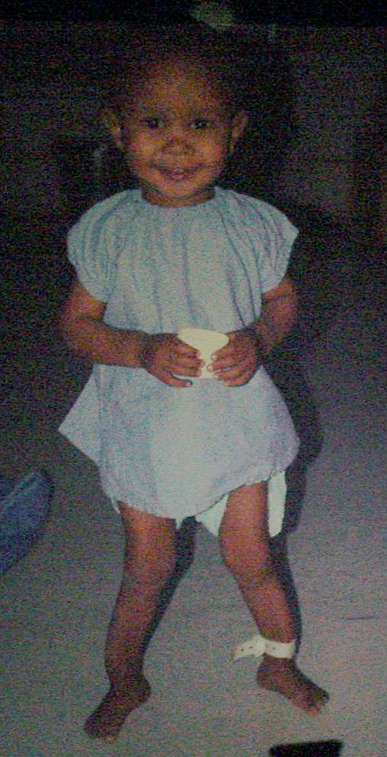

Slide 9
Clinical features
2 year old boy
“Looks fine, just a bit small and crooked” but active and runs around
Wt 10kg(<3rd C) Ht 75cm(3rd C)
BP 130/70
Deformed legs, wide wrists, prominent forehead
Nothing much else to find
Xray: Severe ricketts

Slide 10
Blood results
Hb 7
MCV 85
WC 5
Plt 200
Na 130 K 5.0
U 18 Cr 200
Ca 2.1 Po4 2.2
ALP 180
PTH 30(1-6)
Ven gas
pH 7.25
Be –15
Bic 12

Slide 11
Glomerular filtration rate
GFR is equal to the sum of the filtration rates in all of the functioning nephrons; thus, estimation of the GFR gives a rough measure of the number of functioning nephrons
Creatinine- absolute v/s calculated GFR
Shwartz formula – height x coefficient/creatinine
75 x 40/200 = 15ml/min/1.73 m²
The work group on chronic kidney disease (CKD) for the Kidney Disease Outcome Quality Initiative (K/DOQI)

Slide 12
Aims of CRF Management
be normal - like your friends
feel normal - well
- intellectual development
- school / other activities
maintain normal growth
preserving normal family functioning
slow progression to ESRF
prepare for ESRF treatment

Slide 13
Management strategy
Prevent further damage to the kidneys
Slow down the track to end stage renal disease
Management of complications of CKD

Slide 14
Prevention of further damage
Decreased renal perfusion –
Hypovolemia (such as arising from vomiting, diarrhea, diuretic use, bleeding),
infection (such as sepsis)
the administration of drugs that lower the GFR (NSAIDS,ACE inhibitors, ARBs)
. Administration of nephrotoxic drugs

Slide 15
NATURAL HISTORY OF RENAL DISEASE
The initial injury to the kidney may result in a variety of clinical manifestations, ranging from asymptomatic hematuria to renal failure requiring dialysis.
Many individuals fully recover and subsequently suffer from little or no sequelae
some patients experience repeated and chronic significant insults to the renal parenchyma resulting in lasting damage.
others in whom the initial disease is either inactive or cured may still develop progressive renal disease due to hemodynamic and other mechanisms.

Slide 16

Slowing progression
In adults with CKD, interventions to slow the progression of kidney disease that have been proven to be effective
strict blood pressure control
ACE inhibitor or ARB therapy
There are no data in children with CKD that relate the slowing of progressive renal disease with antihypertensive therapy.
Franscini, LM, Von Vigier, RO, Pfister, R, et al. Effectiveness and safety of the angiotensin II antagonist irbesartan in children with chronic kidney diseases. Am J Hypertens 2002; 15:1057.
Hogg, RJ, Furth, S, Lemley, KV, et al. National Kidney Foundation's Kidney Disease Outcomes Quality Initiative clinical practice guidelines for chronic kidney disease in children and adolescents: evaluation, classification, and stratification. Pediatrics 2003; 111:1416.
A similar lack of data exists concerning the progression of renal disease and a low protein diet.
Wingen, AM, Fabian-Bach, C, Schaefer, F, Mehls, O. Randomised multicentre study of a low-protein diet on the progression of chronic renal failure in children. European Study Group of Nutritional Treatment of Chronic Renal Failure in Childhood. Lancet 1997; 349:1117.

Slide 17
Complications and management
Anaemia
Nutrition and growth failure
Bone disease
Fluid and elecrolyte balance
Hypertension

Slide 18

Anaemia
the presence of anemia in children is common and has been associated with excessive morbidity and an increased mortality risk
The anemia of CKD, which is due to the reduced production of erythropoietin by the kidney, is principally normocytic and normochromic
finding of microcytosis may reflect iron deficiency, aluminum excess, or certain hemoglobinopathies, while macrocytosis may be associated with vitamin B12 or folate deficiency.
Warady, BA, Ho, M. Morbidity and mortality in children with anemia at initiation of dialysis. Pediatr Nephrol 2003; 18:1055. NKF-K/DOQI Clinical Practice Guidelines for Anemia of Chronic Kidney Disease: update 2000. Am J Kidney Dis 2001; 37:S182.

Slide 19
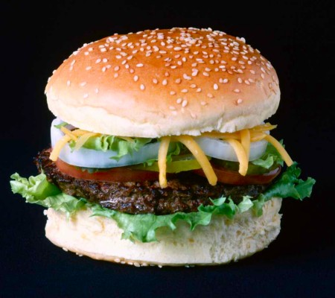
Nutrition
Very very important
Malnutrition is common in children with CKD
poor appetite
decreased intestinal absorption of nutrients
metabolic acidosis.
Attention to nutrition is critical as it affects both the physical growth and neurocognitive development of children

Slide 20
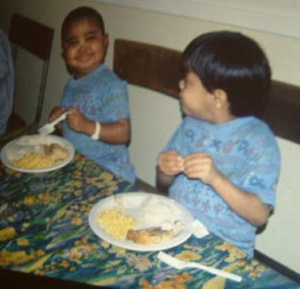
Anorexia

Slide 21
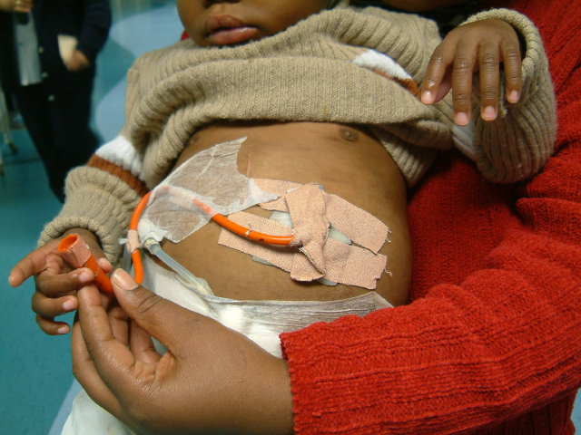
Gastrostomy

Slide 22
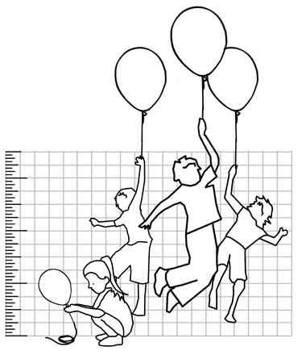

Growth
Growth is the most sensitive indicator of adequacy of CRF treatment
Sub optimal growth is multifactorial in nature - seek and correct growth retarding factors
Growth in infancy is independent of growth hormone

Slide 23

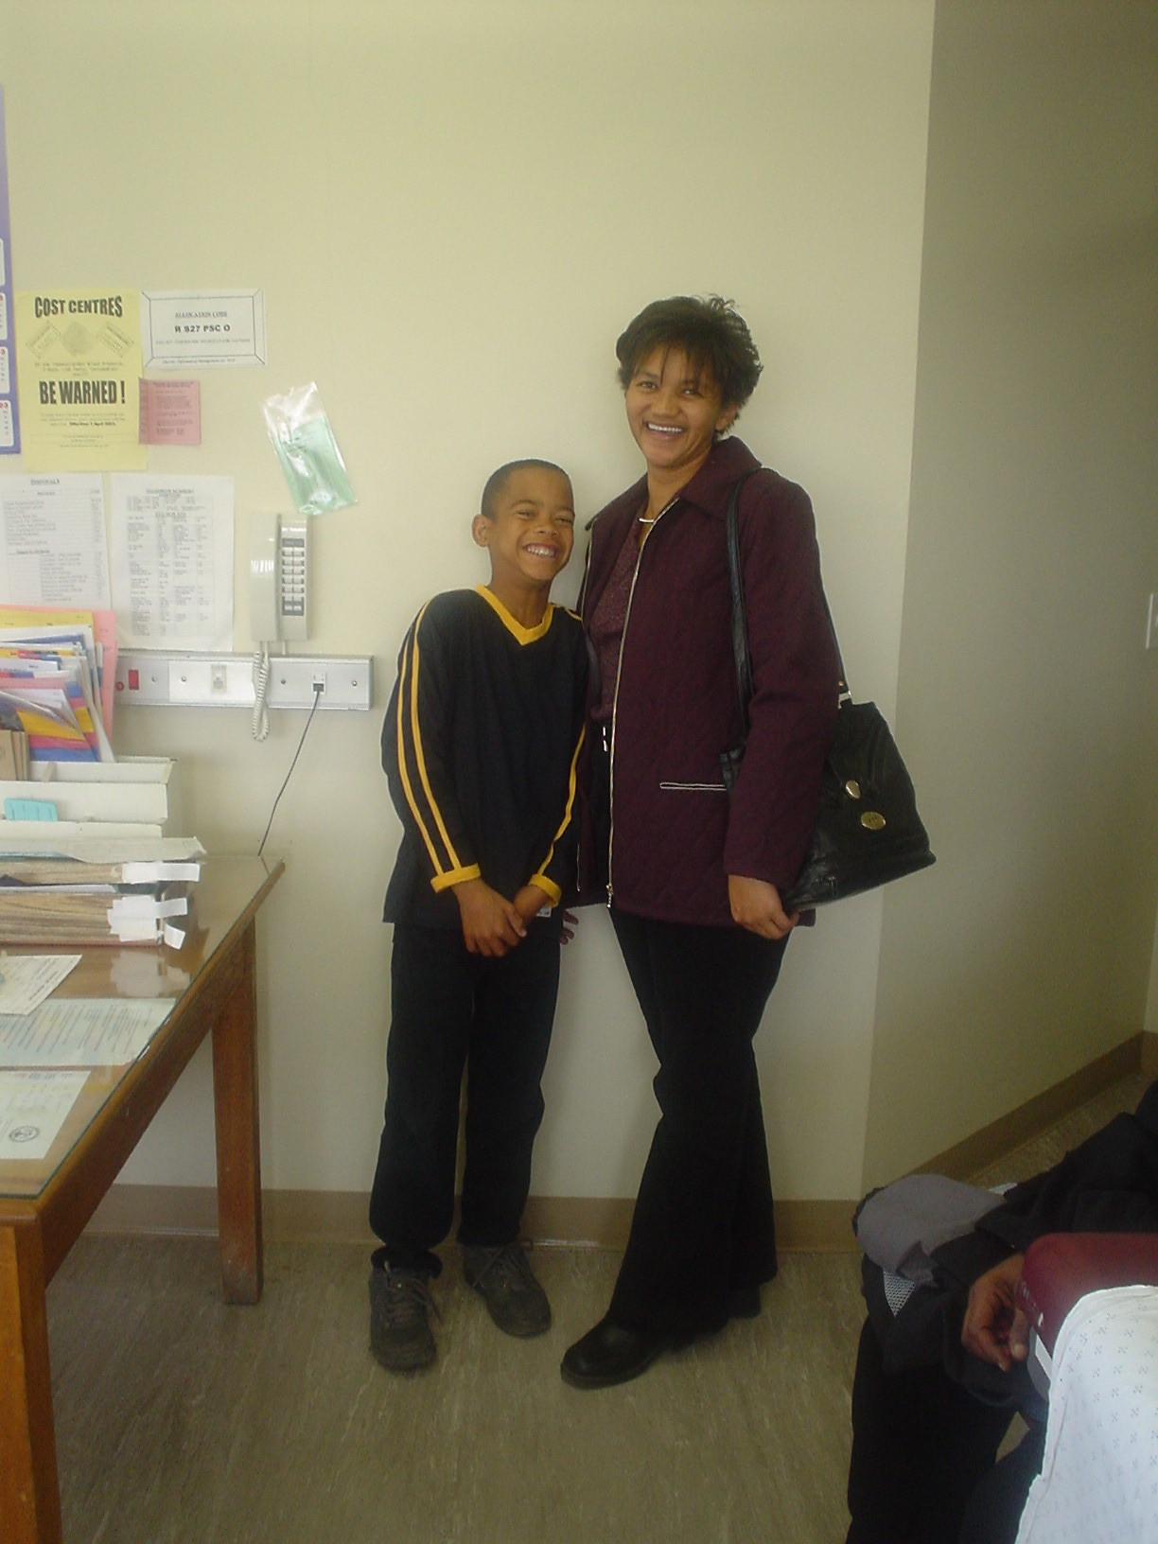
Before and after

Slide 24
Renal osteodystrophy
Aims
to prevent renal osteodystrophy or
reverse established bone disease
to maintain PTH levels within the
normal range

Slide 25
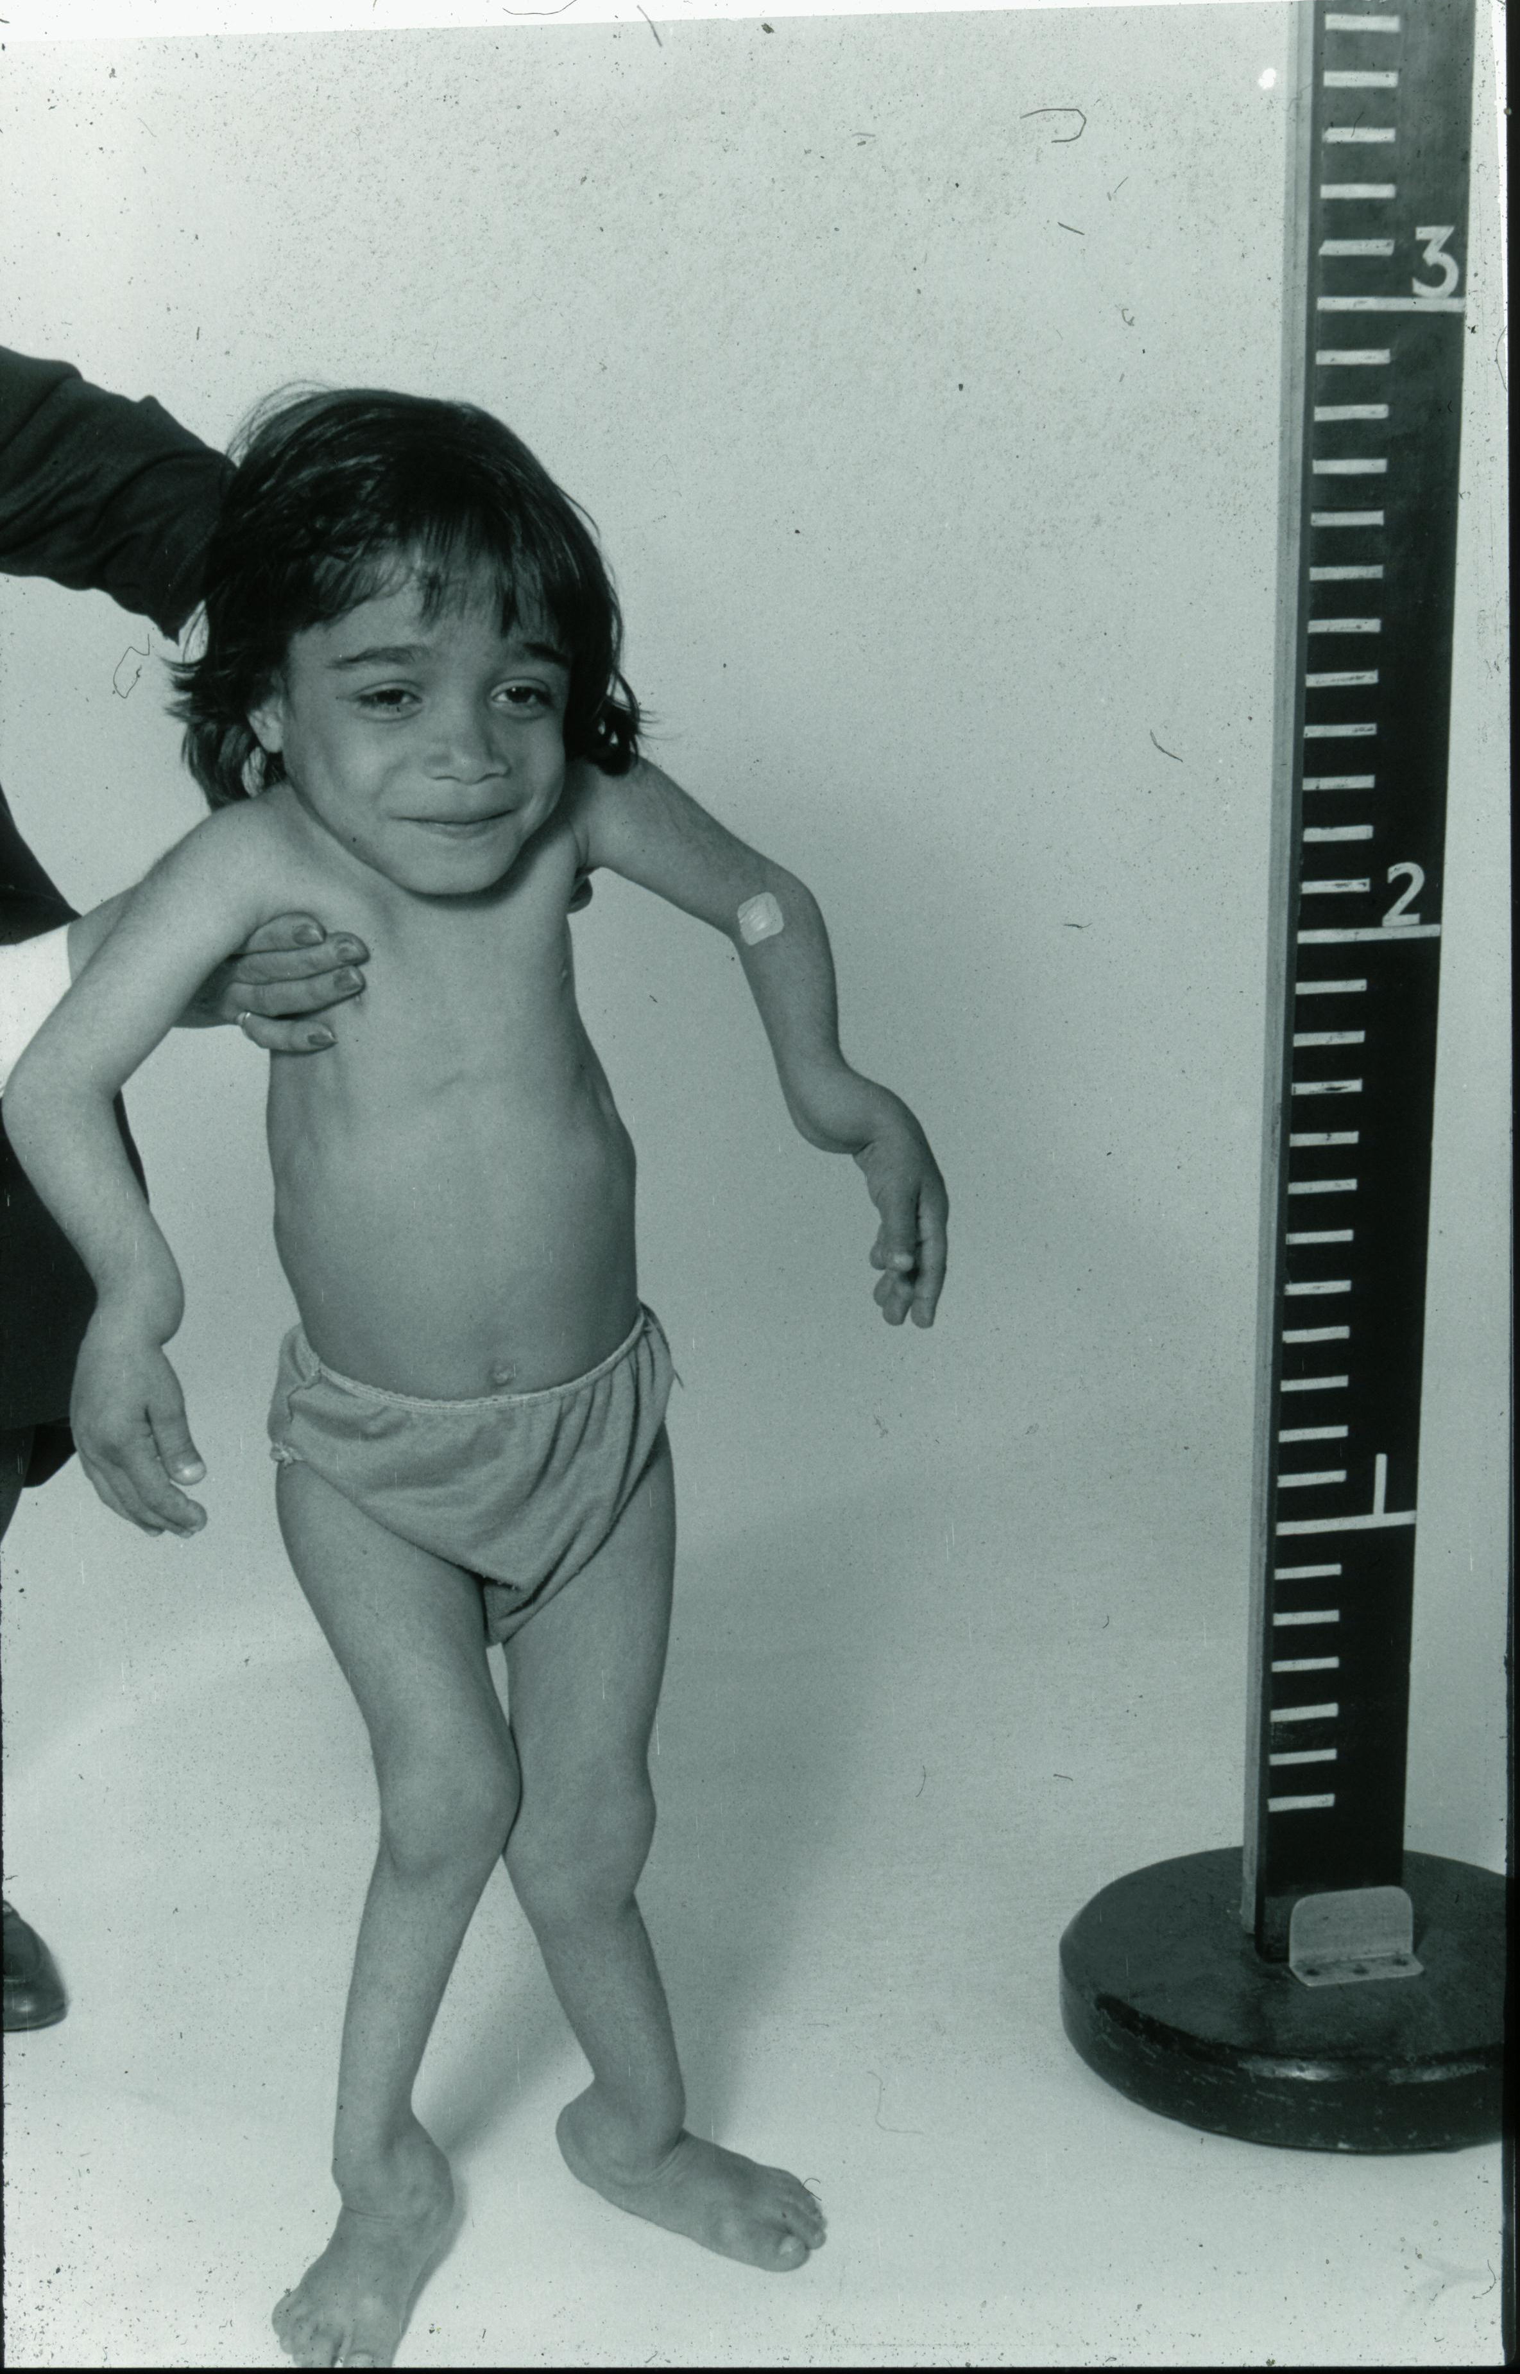

Slide 26
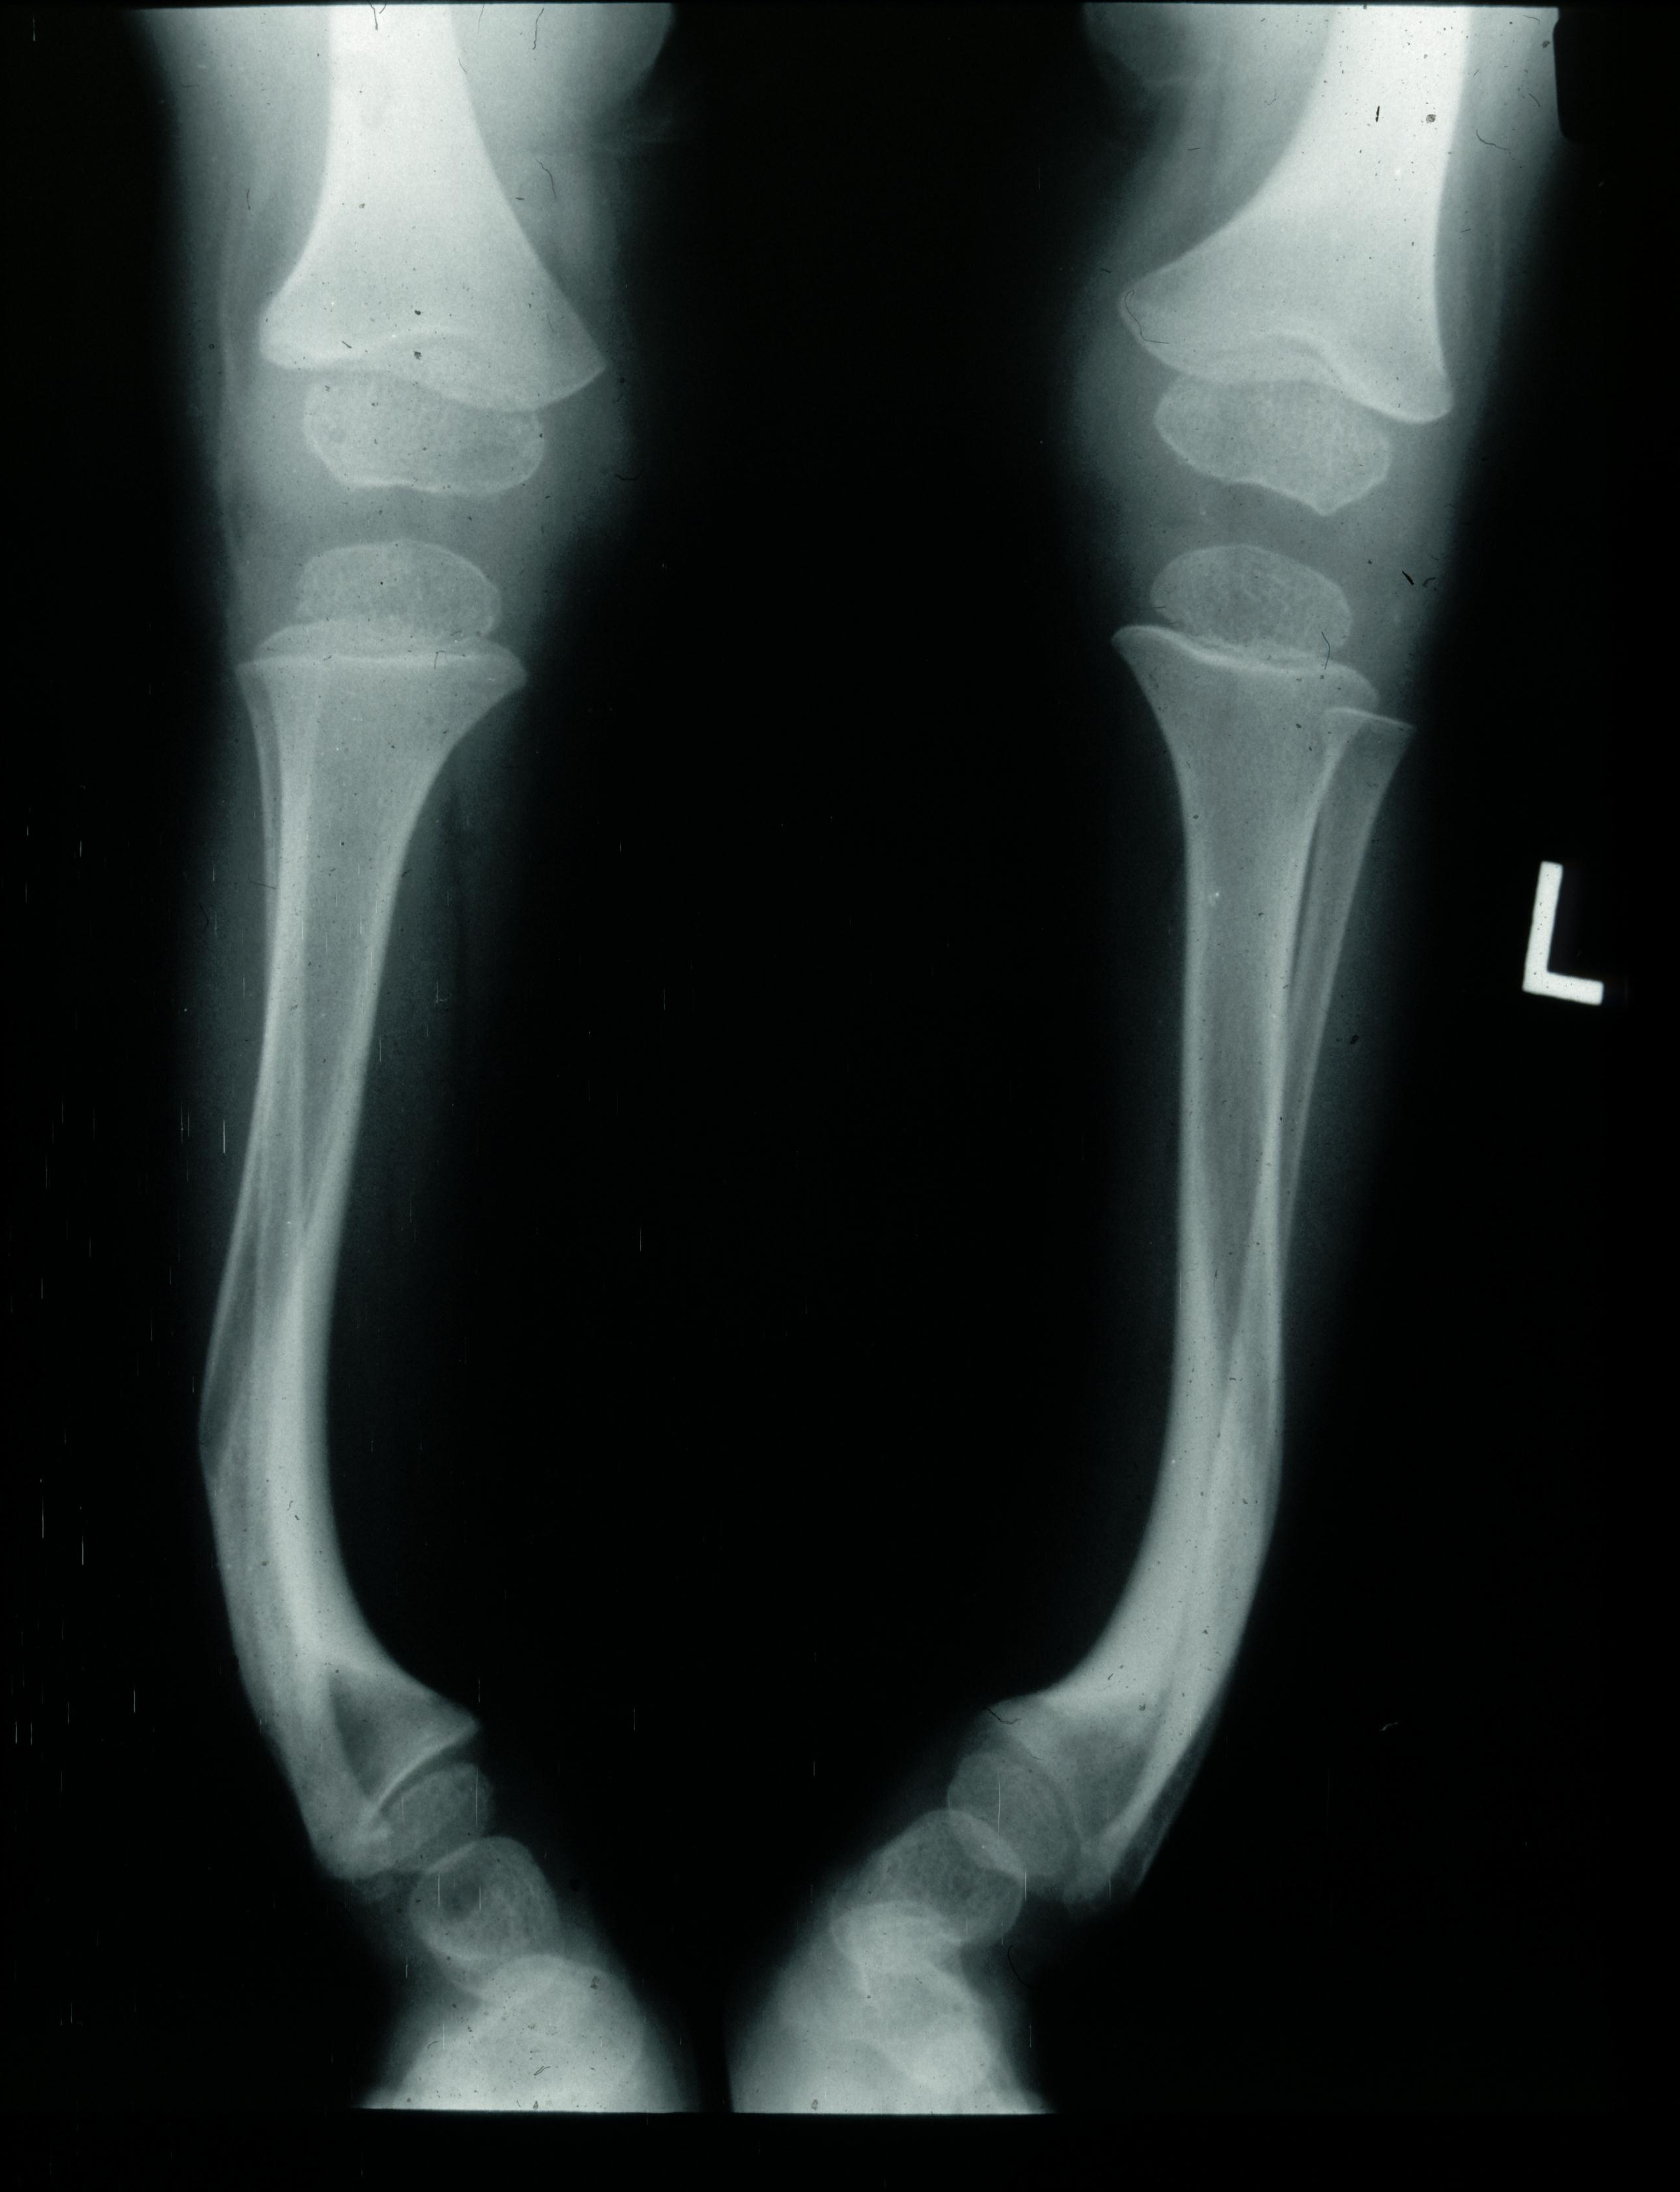

Slide 27
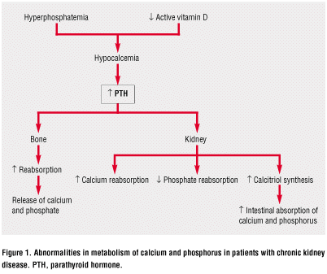

Slide 28
Renal osteodystrophy
Prevention and treatment
control of plasma phosphate by
dietary restriction
phosphate binders
- calcium carbonate
- calcium acetate
- Renagel
- magnesium carbonate

Slide 29

Hypertension
prevalence of hypertension high even with mild reduction in GFR
meticulous control of hypertension BP < 90th centile or 130/80 mmHg
retard the progression of CRF
Weight reduction, exercise, salt 1.2-1.5g/day, thiazide, frusemide, ACE inhibitors, ARB
Soergel, M, Verho, M, Wuhl, E, et al. Effect of ramipril on ambulatory blood pressure and albuminuria in renal hypertension. Pediatr Nephrol 2000; 15:113.

Slide 30
Acid base status
Kidney plays a critical role in acid-base homeostasis by:
Decreased reabsorption of filtered HCO₃
Decrease in renal ammonia production
Decrease distal renal acidification
Overt acidosis GFR <30ml/min/1.73m²
Causes demineralisation of bone to provide buffer thus poor growth and protein degradation
Aim serum HCO >22mmol/l, start at 1 to 2 mEq/kg
Movilli, E, Bossini, N, Viola, BF, et al. Evidence for an independent role of metabolic acidosis on nutritional status in haemodialysis patients. Nephrol Dial Transplant 1998; 13:674.
Graham, KA, Reaich, D, Channon, SM, et al. Correction of acidosis in CAPD decreases whole body protein degradation. Kidney Int 1996; 49:1396.
Kooman, JP, Deutz, NE, Zijlmans, P, et al. The influence of bicarbonate supplementation on plasma levels of branched-chain amino acids in haemodialysis patients with metabolic acidosis. Nephrol Dial Transplant 1997; 12:2397.

Slide 31
Renal replacement therapy
Peritoneal dialysis- preferred in infants
Haemodialysis
It is important to note that dialysis is only a stop gap measure before TRANSPLANTATION

Slide 32
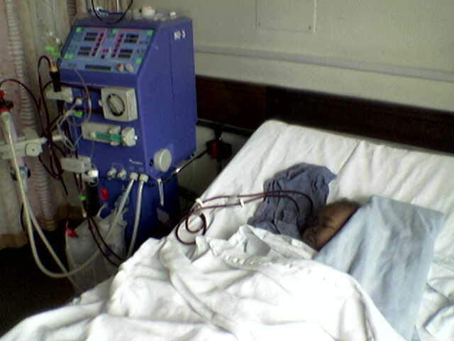
Haemodialysis

Slide 33
Challenges haemodialysis
Access
The right lines
Tubing
Pump speeds
It can be done
CK probably the youngest patient currently on haemodialysis

Slide 34
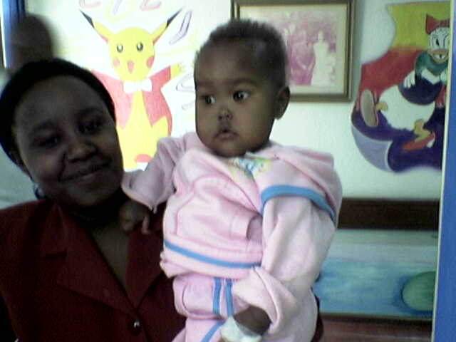
Finally……..

Slide 35
Questions ??

